Slide 1

Depression Detection from Social Media Comments Using Deep Learning (Task 4)
Group No: 14
Group Members:
Syed Md. Ahnaf Hasan (ID: 23266008)
Md. Tanvir Hossain (ID: 24166030)

Slide 2
Outline
Objectives
Literature Review
Dataset Overview + EDA
Preprocessing (Tokenization)
Methodology
Workflow
Architecture of RNN models
Hyperparameters
GloVe
BERT Base Uncased
LIME
Performance Metrics
Experiment Results and Analysis
Performance Analysis of the Models
LIME Interpretation
Conclusion & Future Work
Links to Reference Codes

Slide 3
Objectives
Training and evaluating the performances of various deep learning models: RNN, LSTM, GRU models and a pre-trained transformer BERT Base Uncased model for the task of detecting depression from text in social media
Interpreting the predictions using the LIME XAI

Slide 4
Literature Review
Ser | Paper title | Dataset Used | Techniques Used | Results and Findings
1 | Early Depression Detection from Social Network Using Deep Learning Techniques | CLEF eRisk 2017 dataset | Bidirectional LSTM with Word2Vec and GloVe Embeddings | Using Word2Vec Embeddings with BiLSTM attained the highest F1 score (0.81)
2 | Naïve Bayes Classifier for depression detection using text data | CLEF 2020 dataset | Naïve Bayes, Logistic Regression, Random Forest and SVM | Naïve Bayes Classifier attains the highest accuracy (83%) of the models used
3 | Evaluating text classification with explainable artificial intelligence | Collected from “SWOT’s Guide to KARACHI’s Restaurants Cafes Dhabas HBFE & Takeouts” | Naïve Bayes, Logistic Regression, Random Forest and SVM ML algorithms were used with LIME XAI | Random Forest model obtained the highest accuracy (95%). LIME explanations can improve faith in the model's predictions

Slide 5
Literature Review
Ser | Paper title | Dataset Used | Techniques Used | Results and Findings
4 | Exploring the Impact of Word Embedding Dimensions on Depression Data Classification Using BiLSTM Model | Kaggle Reddit Depression Dataset | GloVe and Word2Vec embeddings used with BiLSTM | Combined with BiLSTM Word2Vec outperformed GloVe with an accuracy of 96.22%
5 | Depression Classification From Tweets Using Small Deep Transfer Learning Language Models | Dataset was curated from Twitter and annotated using VADER and TextBlob | Electra Small Generator, Xtremedistill-16, Albert base V2, DistilBert | Electra Small Generator outperforms the other models with an F1 score of 89%
6 | Machine Learning-based Approach for Depression Detection in Twitter Using Content and Activity Features | Dataset was curated from Twitter using the Twitter Search API and manually Annotated | Naive Bayes, Decision Tree, SVM, | Out of all the models SVM attained the best performance, though the performance across all the metrics were below 80%

Slide 6
Literature Review
Ser | Paper title | Dataset Used | Techniques Used | Results and Findings
7 | DAC Stacking: A Deep Learning Ensemble to Classify Anxiety, Depression, and Their Comorbidity From Reddit Texts | SMHD (Self-reported Mental Health Diagnoses) Dataset | A stacking ensemble of LSTM, CNN and Hybrid LSTM-CNN architectures and a dense neural network meta learner was used | The ensemble technique outperformed all the existing solutions however, there were limitations to this approach as well in detecting proper features for classification. The authors suggested that pretrained transformers such as BERT be explored
8 | Unmasking Depression via Attention-modulated Text Analysis using Deep Learning | Used 2 datasets. First dataset was curated from Reddit by using PushShift API. Second dataset was collected from Kaggle | LSTM, GRU, AlBERT, DistilBERT, CNN, attention mechanism | Each model performed well with attention mechanism. The DistilBERT combined with BiLSTM outperformed all other models across all metrics with an accuracy of 90.92%

Slide 7
Literature Review
Ser | Paper title | Dataset Used | Techniques Used | Results and Findings
9 | A Trustable LSTM-Autoencoder Network for Cyberbullying Detection on Social Media Using Synthetic Data | TRAC-2 Workshop dataset, comprising 25,000 comments from Facebook, Youtube, and Twitter in English, Bengali, and Hindi | LSTM, BiLSTM, LSTM-Autoencoder, Word2vec, BERT, and GPT-2 | Achieved significant accuracy of 99% on raw English data, 95% on semi-noisy Bangla data, and 92% on noisy English data
10 | DeepScreen: Boosting Depression Screening Performance with an Auxiliary Task | DAIC-WOZ (Distress Analysis Interview Corpus Wizard of Oz), It includes audio, transcripts, facial features, and depression screening scores of 189 participants | GRU-D and BRITS | A notable 13.4% enhancement in depression screening F1 score, with DeepScreen achieved an exceptional F1 score of 0.85
11 | Deep Learning Approach for Classifying the Aggressive Comments on Social Media: Machine Translated Data Vs Real Life Data | Trac-2 workshop Dataset containing social media texts with aggressive content | Pre-trained language models including BERT and GPT-2 | BERT achieved accuracy of 0.79 on English data. On the other hand, BERT Multilingual recorded 0.72 and 0.69 on Bangla and Hindi datasets

Slide 8
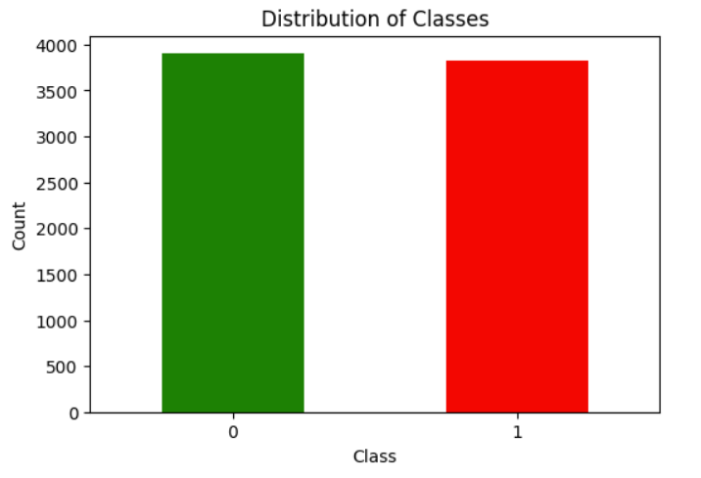
Dataset Overview + EDA
We will use the “Depression: Reddit Dataset (Cleaned)” used in the paper titled “Exploring the Impact of Word Embedding Dimensions on Depression Data Classification Using BiLSTM Model”. Link: https://www.kaggle.com/datasets/infamouscoder/depression-reddit-cleaned/code
The dataset contains 7731 labeled user comments with label ‘1’ indicating depression and ‘0’ indicating no depression.

Slide 9
Dataset Overview + EDA
The dataset contains 2 columns: “clean_text” and “is_depression” which contain the texts and labels of the text respectively.
The text in the dataset was a cleaned as it had no punctual marks, symbols, etc. And the text was in lower case as well.
There are 3900 non depressive instances (label 0) and 3831 depressive instances (label 1). Two instances of the 2 available classes from the dataset are shown below:
clean_text | is_depression
i dont even deserve to live | 1
sooo sick of the snow ughh | 0

Slide 10
Preprocessing (Tokenization)
To feed the data to the deep learning models they need to be converted to numerical forms. For this purpose we use tokenization.
Tokenization assigns an integer value to each word or token in a text.
For the RNN models, we use the tokenizer class from keras library to create a tokenizer. Then we fit the tokenizer with the training split from the dataset. Then we apply zero padding and truncation to make all the sequences of the same length.
For Bert Base uncased model, the Bert Tokenizer from hugging face library is used. This tokenizer handles the tokenization as well as padding and truncation.

Slide 11
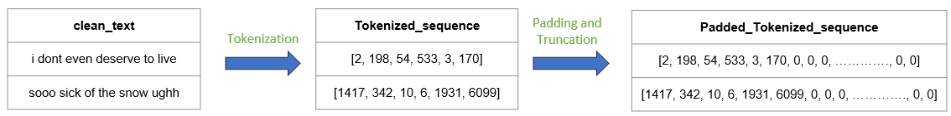
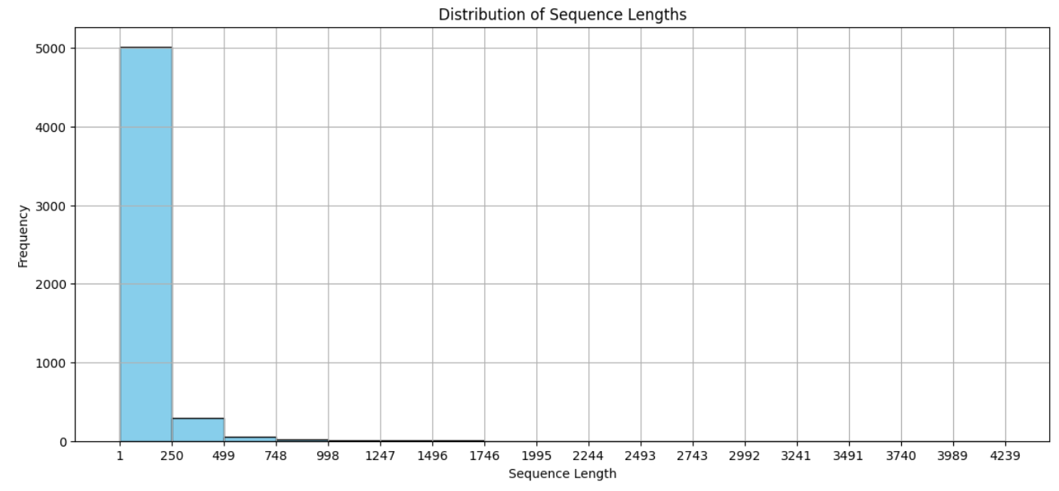
Preprocessing (Tokenization)
The max sequence length among all the instances is found to be 4239.
Majority lie within 250 sequence length. Therefore, chosen max length for all sequences is 250. Smaller sequences will be padded and longer will be truncated.

Slide 12
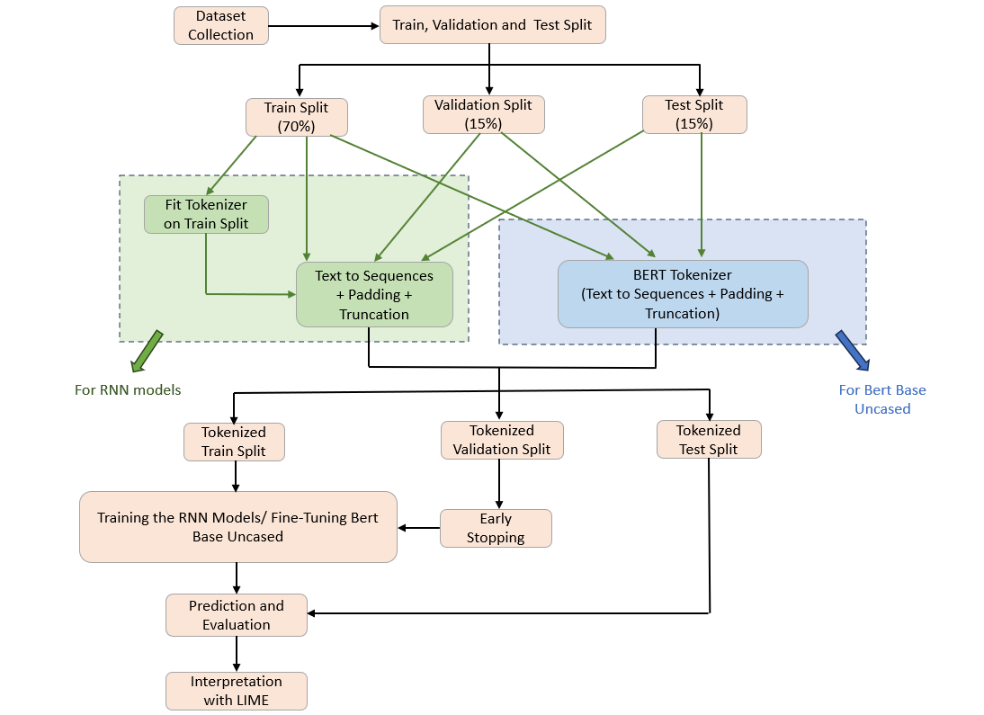
Methodology (Workflow)

Slide 13
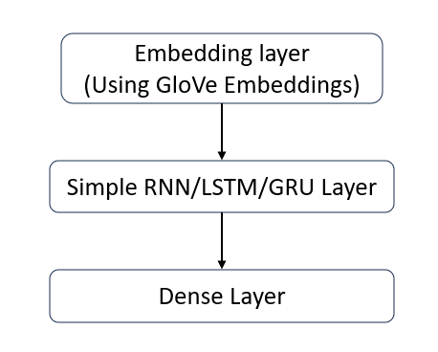
Methodology (Architecture of RNN Models)
The first layer used in the RNN models is the embedding layer. This Layer uses the GloVe pre-trained embeddings to convert the tokens in the text sequences to word vectors to provide more context. The dimension of embeddings is 100.
The second layer contains either Simple RNN/LSTM/GRU layer of 32 units. Both unidirectional and Bidirectional variations of the mentioned layers are used in individual models.
The final layer contains a dense unit with a sigmoid activation function which will be used for generating probabilities for the labels for classification.

Slide 14
Methodology (Hyperparameters)
Parameter Name | Value
Simple RNN/LSTM/GRU units | 32
Vocabulary Size of Tokenizer (For RNN models) | 10000
Max length of sequences (After padding and truncation) | 256
Word Embedding Dimension | 100
Early Stopping Patience | 3

Slide 15
Methodology (GloVe)
GloVe: Global Vectors for Word Representation is a technique to generate word embeddings. Word embeddings incorporate the different aspects of a word’s meaning.
The GloVe 6B 100d pretrained word embeddings were used. There are 4,00,000 word embeddings available in this embeddings set.
The GloVe embeddings are used in the embedding layer of the RNN models.

Slide 16
Methodology (BERT Base Uncased)
BERT: Bidirectional Encoder Representations from Transformers is a encoder based transformer model which is pretrained on a large corpus.
BERT base uncased which is a variant of BERT from Hugging face Transformers library is used in this project.
BERT base uncased has got 110 million parameters

Slide 17
Methodology (LIME)
LIME: Local Interpretable Model-agnostic Explanations is an explainable (XAI) model, used to interpret local predictions made by a black box model.
It explains a model’s prediction for a data instance based on the importance given to each of its features.
It can help to improve the faith in a black box deep learning model’s predictions.
LIME is used in this project to explain local predictions made by the trained models.

Slide 18
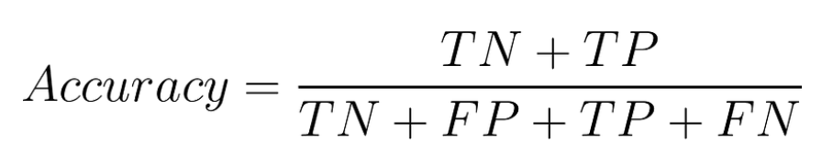
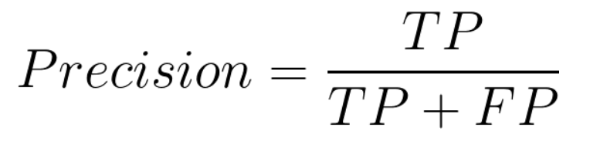
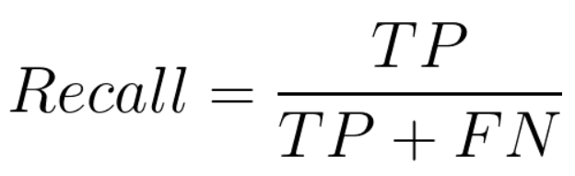
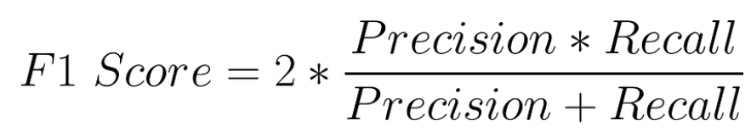
Methodology (Performance Metrics)

Slide 19
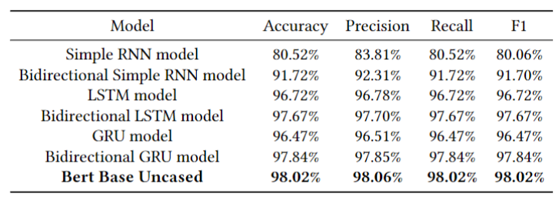
Experiment Results and Analysis (Performance Analysis of the Models)
Table: Evaluation of the models for test set
BERT Base Uncased outperforms the other models across the performance metrics.

Slide 20
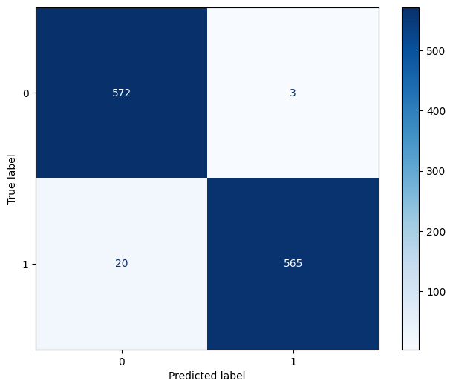
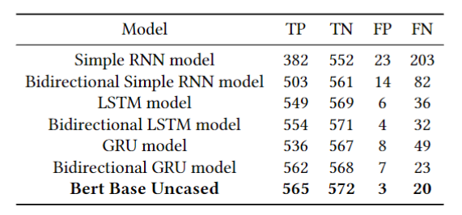
Experiment Results and Analysis (Performance Analysis of the Models)
Table: Summary of Confusion Matrices
Fig. Confusion Matrix of BERT Base Uncased

Slide 21
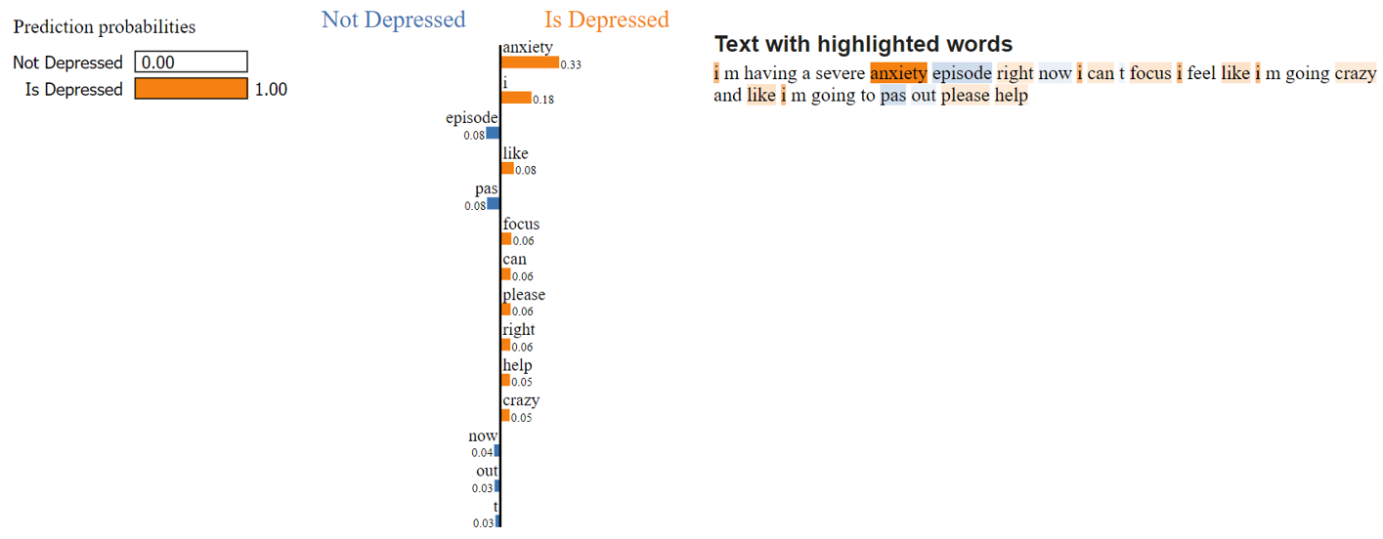
Experiment Results and Analysis (LIME Interpretation)
Fig. LIME Interpretation of a depressive text classified by BERT Base Uncased

Slide 22
Conclusion & Future Work
Conclusion:
BERT Base Uncased outperforms the other models for the task.
LIME interpretations provide insights to the predictions made.
Future Work:
Larger and more diverse dataset can be used.
Other pretrained models may be fine tuned and analyzed.
More complex RNN models may be used.
Other XAI models can be used to gain more insight.

Slide 23
Links to the Reference Codes
The codes used in the following links were referred for out project:
https://nzlul.medium.com/the-classification-of-text-messages-using-lstm-bi-lstm-and-gru-f79b207f90ad
https://www.sabrepc.com/blog/Deep-Learning-and-AI/text-classification-with-bert
https://coderzcolumn.com/tutorials/machine-learning/how-to-use-lime-to-understand-sklearn-models-predictions#lime_image

Slide 24
THANK YOU

